Slide 1
Web Technology
Unit -2

Slide 2
Learning Objectives
ASP.Net, Working with ASP.Net Web Forms: Building ASP.Net Page, Building Forms with
Web Server Controls, Performing Form Validation with Validation Control, Advanced Control
Programming. Working with ADO.Net: Introduction to ADO.Net, Binding Data to web Control,
Using the DataList and DataGrid Controls, Working with DataSets, Working with XML.

Slide 3
ASP.NET Page Life Cycle
When an ASP.NET page runs, the page goes through a life cycle in which it performs a series of processing steps.
These include initialization, instantiating controls, restoring and maintaining state, running event handler code, and rendering.
It is important for us to understand the page life cycle so that you can write code at the appropriate life-cycle stage for the effect you intend.

Slide 4
Page Life-Cycle Stages
Page request :
The page request occurs before the page life cycle begins. When the page is requested by a user, ASP.NET determines whether the page needs to be parsed and compiled (therefore beginning the life of a page), or whether a cached version of the page can be sent in response without running the page.
Start :
In the start stage, page properties such as Request and Response are set. At this stage, the page also determines whether the request is a postback or a new request and sets the IsPostBack property.

Slide 5
Page Life-Cycle Stages Contd..
Initialization :
During page initialization, controls on the page are available and each control's UniqueID property is set.
A master page and themes are also applied to the page if applicable.
If the current request is a postback, the postback data has not yet been loaded and control property values have not been restored to the values from view state.
Load :
During load, if the current request is a postback, control properties are loaded with information recovered from view state and control state.

Slide 6
Page Life-Cycle Stages Contd..
Postback event handling :
If the request is a postback, control event handlers are called. After that, the Validate method of all validator controls is called, which sets the IsValid property of individual validator controls and of the page. (There is an exception to this sequence: the handler for the event that caused validation is called after validation.)
Rendering :
Before rendering, view state is saved for the page and all controls. During the rendering stage, the page calls the Render method for each control, providing a text writer that writes its output to the OutputStream object of the page's Response property.

Slide 7
Page Life-Cycle Stages Contd..
Unload :
The Unload event is raised after the page has been fully rendered, sent to the client, and is ready to be discarded.
At this point, page properties such as Response and Request are unloaded and cleanup is performed.

Slide 8
Web Server Controls
Web controls are very similar to the HTML server controls such as Button, TextBox, and Hyperlink, except that Web controls have a standardized set of property names.
Web server controls offer the following advantages: Make it easier for manufacturers and developers to build tools or applications that automatically generate the user interface.
The System.Web.UI.WebControls.WebControl base class contains all of the common properties. Most of the Web server controls derive from this class.

Slide 9
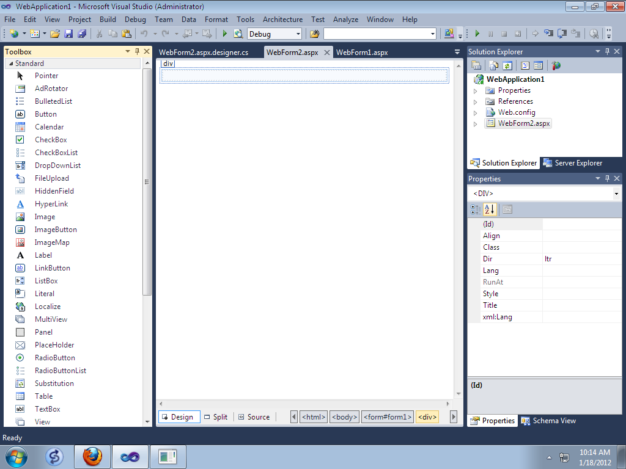


Slide 10
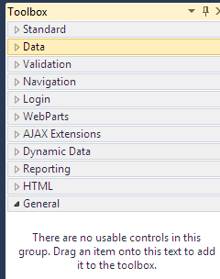
Web Server Controls Categories
Standard Controls
Validation Controls
Data Controls
Rich Controls

Slide 11
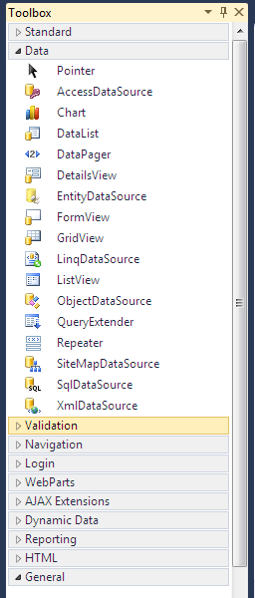
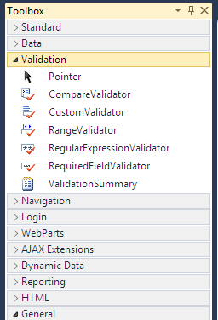
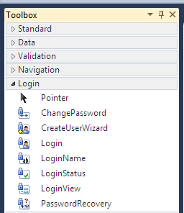
Web Server Controls

Slide 12
Standard Web Controls
Button Web Server Control CheckBox Web Server Control
HyperLink Web Server Control Image Web Server Control
ImageButton Web Server Control Label Web Server Control
LinkButton Web Server Control
Literal Web Server Control
Panel Web Server Control
PlaceHolder Web Server Control
RadioButton Web Server Control
Table Web Server Control
TableCell Web Server Control
TableRow Web Server Control
TextBox Web Server Control

Slide 13
ASP: Text Box
A basic TextBox:
<asp:TextBox id="tb1" runat="server" />
A password TextBox:
<asp:TextBox id="tb2" TextMode="password" runat="server" />
A TextBox with text:
<asp:TextBox id="tb4" Text="Hello World!" runat="server" />
A multiline TextBox:
<asp:TextBox id="tb3" TextMode="multiline" runat="server" />
A TextBox with height:
<asp:TextBox id="tb6" rows="5" TextMode="multiline"
runat="server" />
A TextBox with width:
<asp:TextBox id="tb5" columns="30" runat="server" />

Slide 14
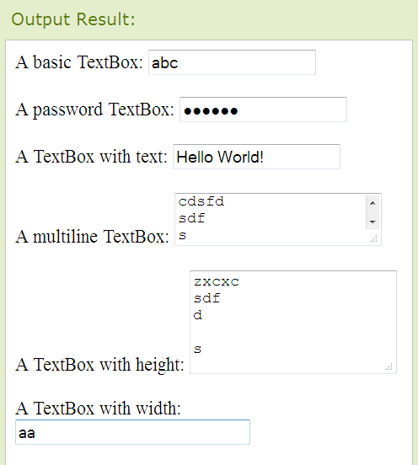
Output

Slide 15
<asp:Button id >
<asp:Button id="b1" Text="Submit" runat="server" />
<script runat="server">
protected void btnDelete_Click(object sender, EventArgs e)
{ lblResult.Text = "All pages deleted!“; }
</script>
Enter your name:
<asp:TextBox id="txt1" runat="server" />
<asp:Button OnClick="btnDelete_Click" Text="Submit" runat="server" />
<p><asp:Label id="lbl1" runat="server" /></p>

Slide 16
<asp:RadioButton>
<asp:RadioButton id="rdlMagazine” Text="Magazine Article"
GroupName="Source” Runat="server" />
<asp:RadioButton id="rdlTelevision” Text="Television Program"
GroupName="Source” Runat="server" />
<asp:RadioButton
id="rdlOther” Text="Other Source"
GroupName="Source” Runat="server" />
<asp:Button id="btnSubmit” Text="Submit"
Runat="server" OnClick="btnSubmit_Click" />
protected void btnSubmit_Click(object sender, EventArgs e)
{ if (rdlMagazine.Checked) lblResult.Text = rdlMagazine.Text;
if (rdlTelevision.Checked) lblResult.Text = rdlTelevision.Text;
if (rdlOther.Checked) lblResult.Text = rdlOther.Text; }

Slide 17
<asp:HyperLink>
<asp:HyperLink
id="lnkRandom"
Text="Random Link"
Runat="server" />
void Page_Load()
{
lnkRandom.NavigateUrl = “www.yahoo.com”
}

Slide 18
<asp:Image>
void Page_Load()
{ Random rnd = new Random();
switch (rnd.Next(2))
{ case 0:
imgRandom.ImageUrl = "Picture1.gif";
imgRandom.AlternateText = "Picture 1"; break;
case 1:
imgRandom.ImageUrl = "Picture2.gif";
imgRandom.AlternateText = "Picture 2"; break; } }
<asp:Image
id="imgRandom"
Runat="server" />

Slide 19
<asp:Label >
void Page_Load()
{
lblTime.Text = DateTime.Now.ToString("T");
}
<asp:Label
id="lblTime"
Runat="server" />

Slide 20
<asp:LinkButton>
protected void lnkSubmit_Click(object sender, EventArgs e)
{
lblResults.Text = "First Name: " + txtFirstName.Text;
lblResults.Text += "<br />Last Name: " + txtLastName.Text;
}
<asp:LinkButton
id="lnkSubmit"
Text="Submit"
OnClick="lnkSubmit_Click"
Runat="server" />

Slide 21
Button Control
Control Code:-
< asp : Button id=“b/” Text=“Submit” runat=“Server”/>
Important property:-
Causes Validation – specifies if a page is validated when a button is clicked.
Command Argument – specifies additional information about the command to perform.
Command Name - specifies the command associated with the command event.
On Client Click – specifies the name of the function to be executed when a button is clicked.
Post Back URL - specifies the URL of the page to post to from the current page when a button is clicked.

Slide 22
Literal Control
Control Code:-
<asp : Literal ID =“Literal/”
runat = “Server”/>
Property of control:-
Text – specifies the text to display (display text on a page).

Slide 23
Radio Button Control
Control Code:-
<asp: RadioButton ID = “RadioButton1”
runat = “server”/>
Property of the control:-
AutoPostBack – specifies whether the form should be posted immediately after the button property has changed or not default is false.
ID – A unique id for the control.
GroupName – The name of the group to which this radio button belongs.
Text – The text next to RadioButton.
TextAlign – on which side of the RadioButton the text should appear(right or left).

Slide 24
Table
Control code:-
<asp : Table ID =“Table1”
runat = “Server”/>
Property of the Control:-
Caption – The caption of the table.
Cell Padding – The space, in pixels between the cells walls and contents.
Cell Spacing – The space in pixels between cells.
Gridlines – The gridline format in the table.
Horizontal align - The horizontal alignment of the table in one page.
Rows – A collection of rows in the table.

Slide 25
CheckBox Control
Control Code:-
<asp: CheckBox ID = “CheckBox 1”
runat =“Server”/>
Property of a control:-
AutoPostBack – specifies whether the form should be posted immediately after the checked property has checked property has changed or not default is false.
Checked – specifies whether the checkbox is checked or not.
Text – the text next to the checkbox.
Text Align – on which side of the checkbox the text should appear(right or left).
On Checked Changed – the name of the function to be executed when the checked property has changed.

Slide 26
Drop Down List Control
Control code:-
<asp : DropDownListID =“DropDownList1” runat =“Server”/>
Property of the control:-
On Selected index changed – the name of the function to be executed when the index of the selected item has changed.

Slide 27
Image Control
Control code:-
<asp:ImageID=“Image1”runat =“Server”/>
Property of the control:-
Alternate Text – an alternate text for the image .
Image Align – specifies the alignment of the image.
Image URL – The URL of the image to display for the link.
Description URL – The location of the detailed description of the image.

Slide 28
List Control
Control code:-
<asp:ListBox ID="ListBox1" runat="server"></asp:ListBox>
Property of the control:-
Selection Mode Enabled – Allows single or multiple selections optional specifies if the item is enabled or not.
Validation Group – specifies the group of controls a button causes validation, when its posts back to the server.

Slide 29
Text Box Control
Control code:-
<asp:TextBoxID=“TextBox”runat =“Server”/>
Property of the control:-
Auto Complete type –specifies the Auto Complete behaviour of a Text box.
Auto Post Back – A boolean value that specifies whether the control is automatically posted back to the sever to the server when the contents change or not default is False.
Columns – The width of the textbox.
Max Length – Maximum number of characters allowed in the textbox.
Rows – Height of the textbox.
Text Mode – specifies the behaviour mode of a TextBox counter (single line , multiline or password).
Read only – specifies whether or not the text in the text in the textbox can be changed.

Slide 30
Validation Controls
Validation controls are used to validate the values that are entered into other controls of the page.
Validation controls perform client-side validation, server-side validation, or both, depending on the capabilities of the browser in which the page is displayed.
Validation controls offer the following advantages:
You can associate one or more validation controls with each control that you want to validate.
The validation is performed when the page form is submitted.
You can specify programmatically whether validation should occur, which is useful if you want to provide a cancel button so that the user can exit without having to fill valid data in all of the fields.
The validation controls automatically detect whether validation should be performed on the client side or the server side.

Slide 31
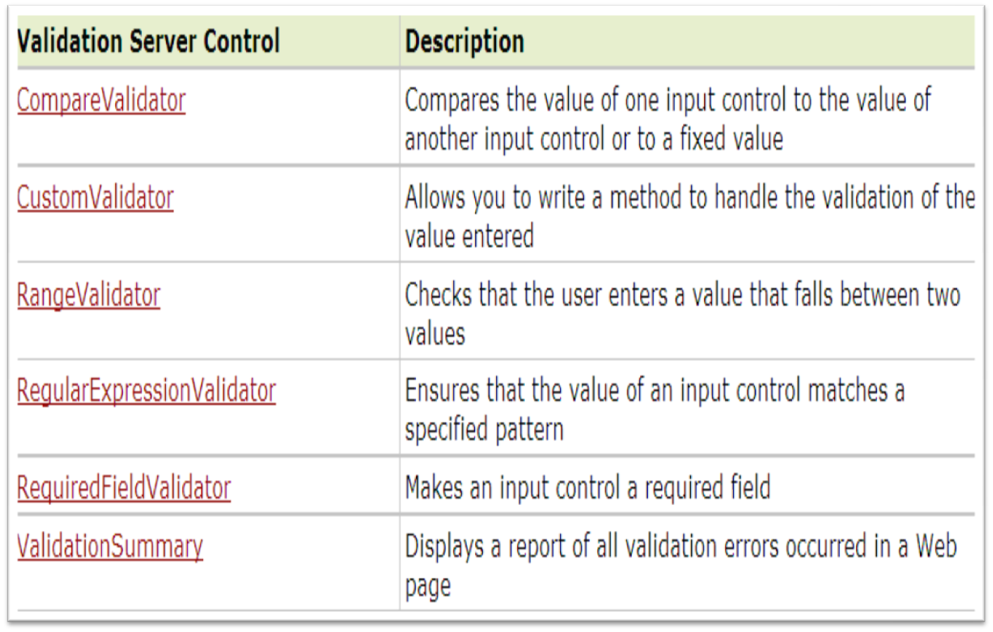
Validation Controls

Slide 32
RequiredFieldValidator
<asp:RequiredFieldValidator
ControlToValidate=“txtname"
Text="The name field is required!"
runat="server" />

Slide 33
<asp:RangeValidator>
<html><body>
<form runat="server">
<p>Enter a number from 1 to 100:
<asp:TextBox id="tbox1" runat="server" />
<asp:Button Text="Submit" runat="server" />
<asp:RangeValidator
ControlToValidate="tbox1"
MinimumValue="1"
MaximumValue="100"
Type="Integer"
Text="The value must be from 1 to 100!"
runat="server" />
</p>
</form></body></html>

Slide 34
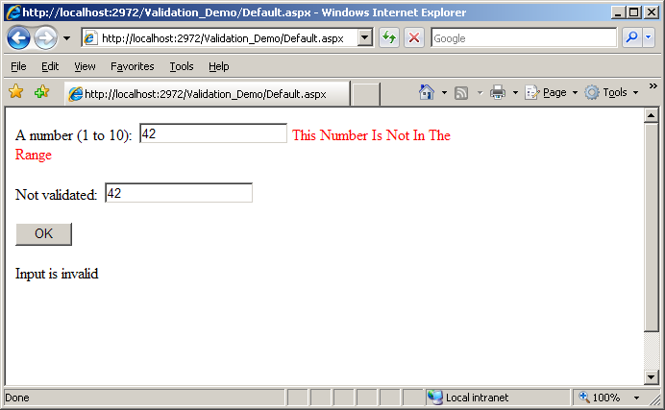
Invalid Input Ex:

Slide 35
CompareValidator
<asp:CompareValidator
id="compval"
Display="dynamic"
ControlToValidate="txt1"
ControlToCompare="txt2"
ForeColor="red"
BackColor="yellow"
Type="String"
EnableClientScript="false"
Text="Validation Failed!"
runat="server" />

Slide 36
RegularExpressionValidator
<asp:RegularExpressionValidator
ControlToValidate="txtbox1"
ValidationExpression="\d{5}"
EnableClientScript="false"
ErrorMessage="The zip code must be 5 numeric digits!"
runat="server" />

Slide 37
CustomValidator
<script runat="server">
Sub user(source As object,args As ServerValidateEventArgs)
if len(args.Value)<8 or len(args.Value)>16 then
args.IsValid=false
else
args.IsValid=true
end if
End Sub</script>
<asp:CustomValidator
ControlToValidate="txt1"
OnServerValidate="user"
Text="A username must be between 8 and 16 characters!"
runat="server"/>

Slide 38
Validation Summary
Control code:-
<asp:ValidationSummary ID=“ValidationSum1”
runat =“Server”/>
Property of the control:-
Display Mode – How to display the summary .Legal values are Bullet list , List , Single paragraph.
Header Text – A header in the Validation summary control.
Show Message Box – A boolean value that specifies whether the summary should be displayed in a message box or not.
Show Summary – A boolean value that specifies whether the validation summary control should be displayed or hidden.

Slide 39
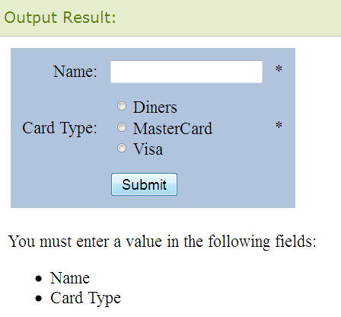
Validation Summary
<asp:ValidationSummary
HeaderText="You must enter a value in the following fields:"
DisplayMode="BulletList"
EnableClientScript="true"
runat="server"/>

Slide 40
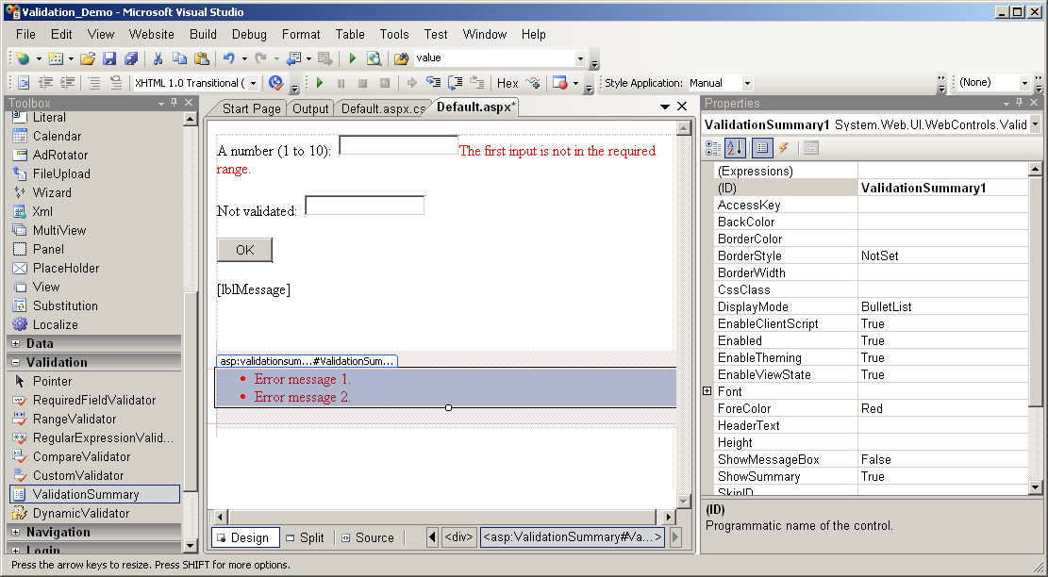
Validation Summary

Slide 41
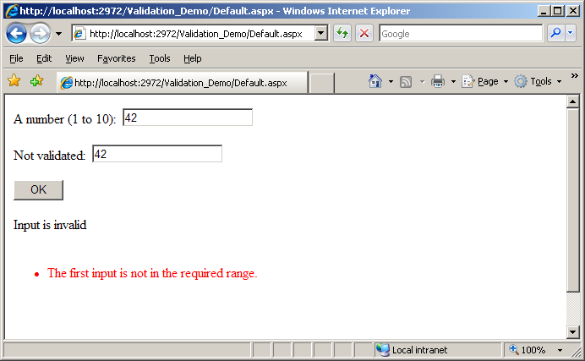
Display Property Set To None

Slide 42
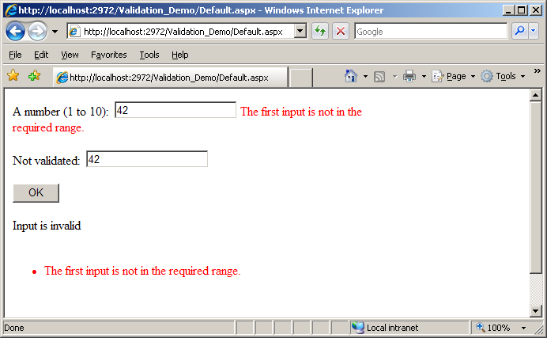
Validation Summary

Slide 43
Rich Controls
In addition to the preceding controls, the ASP.NET page framework provides a few, task-specific controls called rich controls.
Rich controls are built with multiple HTML elements and contain rich functionality.
Examples of rich controls are the Calendar control and the AdRotator control.

Slide 44
AdRotator
Control code:-
< asp : AdRotator_id =“AdRotator1” advertisement file =“ads.Xml” target =“_self” keyword filter =“Small” >
runat = “server”/>
Important Property:-
Advertisement File – specifies the path to the XML file that contains ad information.
Alternate Text field – specifies a data field to be used instead of the Alt text for an ad.
ImageUrlField – specifies a data field to be used instead of the Image URL attribute for an ad.
KeywordFilter – specifies a filter to limit ads after categories.
NavigateUrlField – specifies a data field to be used instead of the Navigate URL attribute for an ad.
Runat – specifies that the control server control.
Target – specifies where to open.

Slide 45
AdRotator Contd..
Definition and Usage
The AdRotator control is used to display a sequence of ad images.
This control uses an XML file to store the ad information. The XML file must begin and end with an <Advertisements> tag. Inside the <Advertisements> tag there may be several <Ad> tags which defines each ad.
The predefined elements inside the <Ad> tag are listed below:
Element | Description
<ImageUrl> | The path to the image file
<NavigateUrl> | The URL to link to if the user clicks the ad
<AlternateText> | An alternate text for the image
<Keyword> | A category for the ad
<Impressions> | The display rates in percent of the hits

Slide 46
<asp:AdRotator ID="AdRotator1" AdvertisementFile="ads.xml" runat="server"
Height="200px" Width="150px" />
--------------ads.xml-------------
<Advertisements>
<Ad>
<ImageUrl>rose1.jpg</ImageUrl>
<NavigateUrl>http://www.1800flowers.com</NavigateUrl>
<AlternateText>
Order flowers, roses, gifts and more
</AlternateText>
<Impressions>20</Impressions>
<Keyword>flowers</Keyword>
</Ad>
<Ad>
<ImageUrl>rose2.jpg</ImageUrl>
<NavigateUrl>http://www.babybouquets.com.au</NavigateUrl>
<AlternateText>Order roses and flowers</AlternateText>
<Impressions>20</Impressions>
<Keyword>gifts</Keyword>
</Ad>
</Advertisements>

Slide 47
Calender Control
Control code:-
<asp:Calendar ID="Calendar1" runat="server”>
</asp:Calendar>
Property of the control:-
Caption – The caption of calender .
Cell Spacing – The space in pixels between cells .
Visible Date – The date that specifies the month that is currently visible in the calender.
Weekend Day Style – The style for weekends.
Day Name Format – The Format for displaying the names of the days.
Prev Month Text – The text displayed for the previous month.

Slide 48
Calender Control Cont..
<script language="C#" runat="server">
void Selection_Change(Object sender, EventArgs e)
{
Label1.Text = "The selected date is " + Calendar1.SelectedDate.ToShortDateString();
}
</script>

Slide 49
Calender Control Cont..
<asp:Calendar ID="Calendar1" runat="server"
OnSelectionChanged="Selection_Change">
</asp:Calendar>
<asp:Button ID="Button1" runat="server" onclick="Button1_Click" Text="Button" />
<asp:Label ID="Label1" runat="server" Text="Label"></asp:Label>

Slide 50
ADO.NET

Slide 51
ADO.NET
ADO.NET is an object-oriented set of libraries that allows you to interact with data sources. Commonly, the data source is a database, but it could also be a text file, an Excel spreadsheet, or an XML file.
As you are probably aware, there are many different types of databases available.
For example:
Microsoft SQL Server,
Microsoft Access,
Oracle,
Borland Interbase, and IBM DB2,

Slide 52
Where does ADO sit?
VB
C#
C++
Jscript
…
Common Language Specification
ASP.Net
Windows Forms
ADO.Net
XML.Net
Visual Studio .NET
Base Class Library
Common Language Runtime (CLR)
Windows
COM+ Services

Slide 53
Data Providers
Provider Name | API prefix | Data Source Description
ODBC Data Provider | Odbc | Data Sources with an ODBC interface. Normally older data bases.
OleDb Data Provider | OleDb | Data Sources that expose an OleDb interface, i.e. Access or Excel.
Oracle Data Provider | Oracle | For Oracle Databases.
SQL Data Provider | Sql | For interacting with Microsoft SQL Server.
Borland Data Provider | Bdp | Generic access to many databases such as Interbase, SQL Server, IBM DB2, and Oracle.

Slide 54
.NET Data Providers
SQL .NET
Data Provider
SQL SERVER
OLE DB .NET
Data Provider
OLE DB
Provider
Client
Other DB
ODBC .NET
Data Provider
ODBC
Driver
Other DB

Slide 55
ADO.NET Objects
The SqlConnection Object
The SqlCommand Object
The SqlDataReader Object
The DataSet Object
The SqlDataAdapter Object

Slide 56
1.The SqlConnection Object
To interact with a database, you must have a connection to it.
The connection helps identify the database server, the database name, user name, password, and other parameters that are required for connecting to the data base.
A connection object is used by command objects so they will know which database to execute the command on.

Slide 57
2.The Sql Command Object
The process of interacting with a database means that you must specify the actions you want to occur.
This is done with a command object. You use a command object to send SQL statements to the database.
A command object uses a connection object to figure out which database to communicate with. You can use a command object alone, to execute a command .

Slide 58
3.The Sql DataReader Object
Many data operations require that you only get a stream of data for reading.
The data reader object allows you to obtain the results of a SELECT statement from a command object.
For performance reasons, the data returned from a data reader is a fast forward-only stream of data.
This means that you can only pull the data from the stream in a sequential manner .
This is good for speed, but if you need to manipulate data, then a DataSet is a better object to work with.

Slide 59
4. The DataSet Object
DataSet objects are in-memory representations of data. They contain multiple Datatable objects, which contain columns and rows, just like normal database tables.
You can even define relations between tables to create parent-child relationships.
The DataSet is specifically designed to help manage data in memory and to support disconnected operations on data, when such a scenario make sense.
The DataSet is an object that is used by all of the Data Providers, which is why it does not have a Data Provider specific prefix.

Slide 60
5.The SqlDataAdapter Object
The data adapter makes it easy for you to accomplish these things by helping to manage data in a disconnected mode.
The data adapter fills a DataSet object when reading the data and writes in a single batch when persisting changes back to the database.
A data adapter contains a reference to the connection object and opens and closes the connection automatically when reading from or writing to the database.
Additionally, the data adapter contains command object references for SELECT, INSERT, UPDATE, and DELETE operations on the data.
You will have a data adapter defined for each table in a DataSet and it will take care of all communication with the database for you. All you need to do is tell the data adapter when to load from or write to the database.

Slide 61
The Sql Connection Object
Creating a SqlConnection Object
A SqlConnection is an object, just like any other C# object. Most of the time, you just declare and instantiate the SqlConnection all at the same time, as shown below:
SqlConnection conn = new SqlConnection(
"Data Source=(local); Initial Catalog=Northwind;Integrated Security=SSPI");
The SqlConnection object instantiated above uses a constructor with a single argument of type string This argument is called a connection string. Table 1 describes common parts of a connection string.

Slide 62
ADO.NET Connection Strings
Connection String Parameter Name | Description
Data Source | Identifies the server. Could be local machine, machine domain name, or IP Address.
Initial Catalog | Database name.
Integrated Security | Set to SSPI (Security service provider interface) to make connection with user's Windows login
User ID | Name of user configured in SQL Server.
Password | Password matching SQL Server User ID.

Slide 63
Methods Summary…
Item | Description
ExecuteReader | Executes the query, and return multiple rows of data that can be accessed through a SqlDataReader object, that is returned, one by one.
ExecuteNonQuery | Executes the query, and does not collect any results. Generally used for queries such as UPDATE, INSERT and DELETE, and specialized commands such as CREATE TABLE and DROP DATABASE commands.
ExecuteScalar | Executes the query, and returns a single value (from the first column of the first row). Most useful for aggregate functions such as: COUNT, MAX, MIN, AVERAGE, etc.

Slide 64
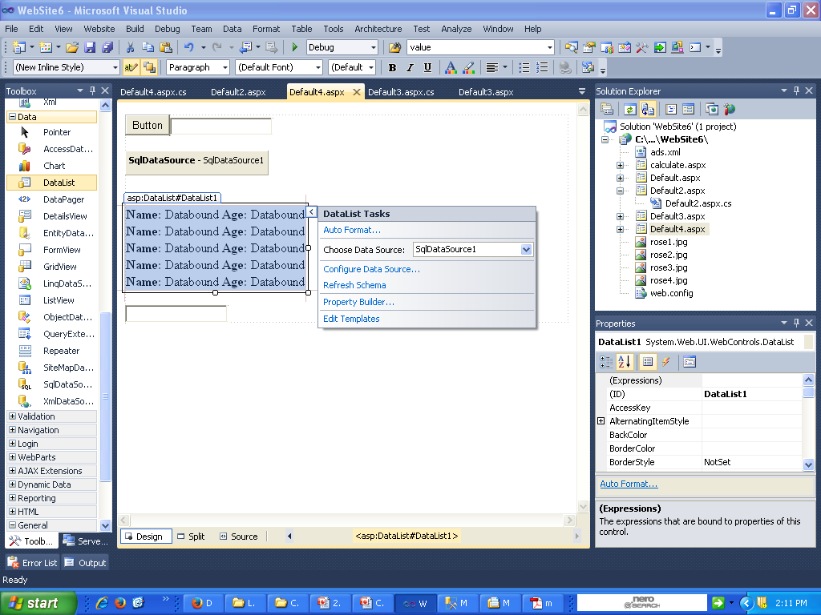
Using Data List

Slide 65
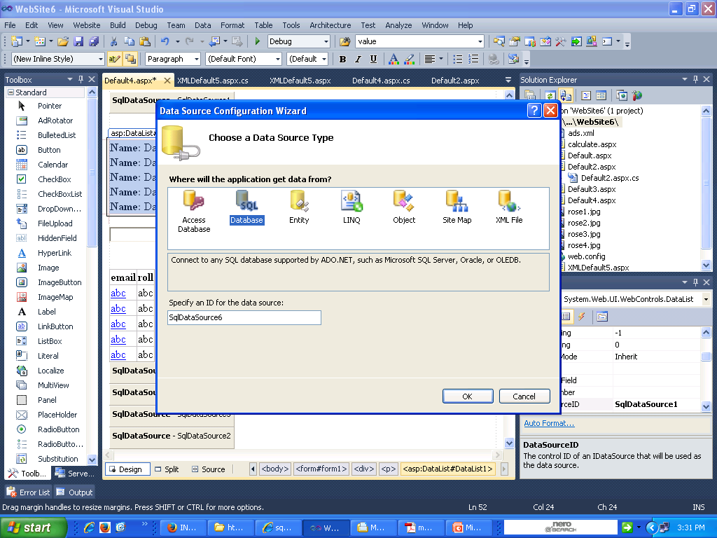

Slide 66
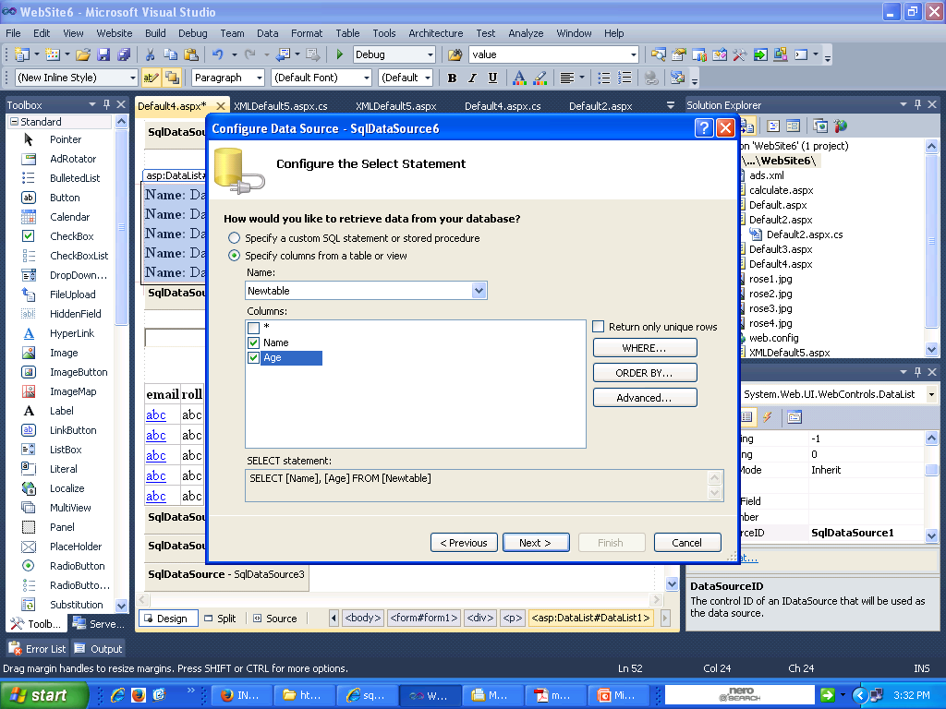

Slide 67
Using Data List Cont…
<asp:SqlDataSource ID="SqlDataSource1" runat="server"
ConnectionString="<%$ ConnectionStrings:ABC_SEPTConnectionString %>"
onselecting="SqlDataSource1_Selecting"
SelectCommand="SELECT DISTINCT [Name], [Age] FROM [Newtable]">
</asp:SqlDataSource>

Slide 68
Using Data List Cont…
<p>This is data List
<asp:DataList ID="DataList1" runat="server" DataSourceID="SqlDataSource1">
<ItemTemplate>
<b>Name: </b><%# DataBinder.Eval(Container.DataItem, "Name") %>
<b>Age: </b>
<%# DataBinder.Eval(Container.DataItem, "Age")%><br />
</ItemTemplate>
</asp:DataList>

Slide 69
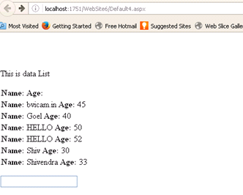
Using Data List Cont…

Slide 70
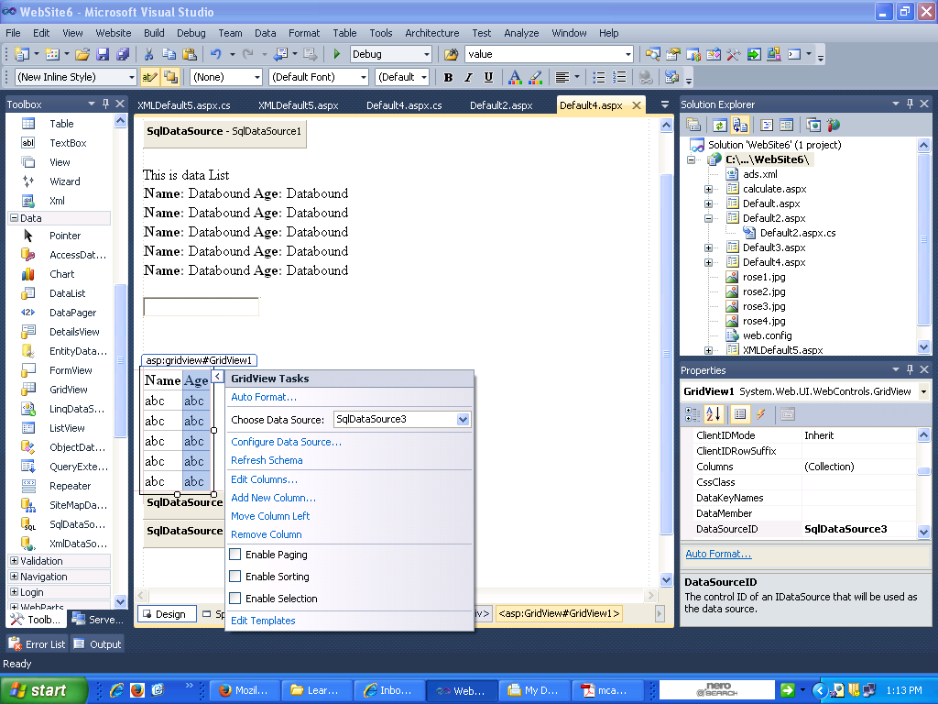
Using DataGrid Control

Slide 71
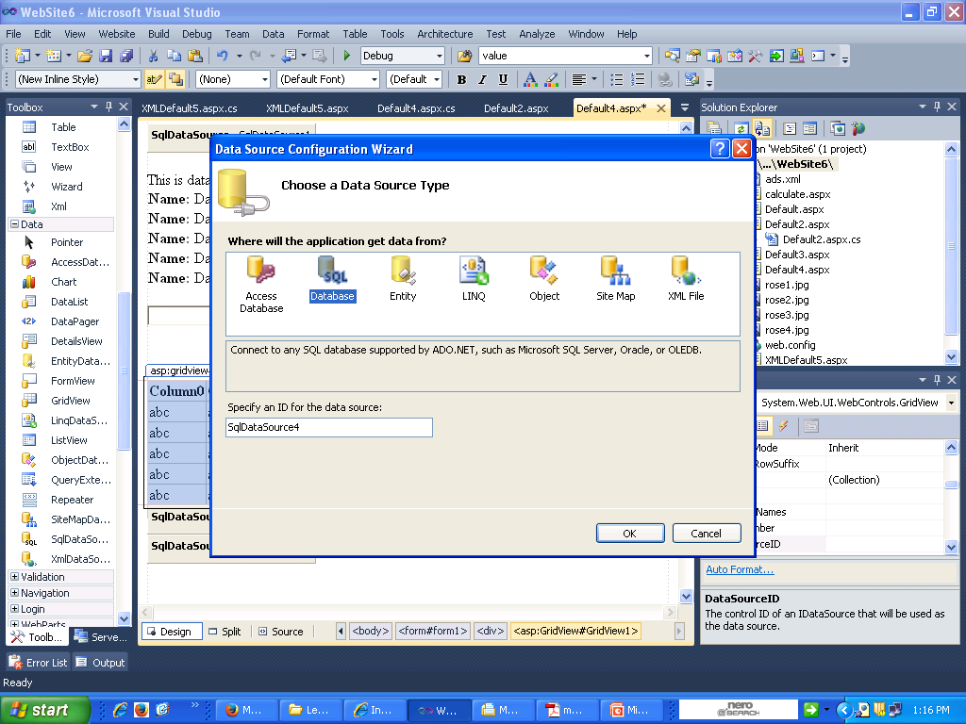
Using DataGrid Control Cont…

Slide 72
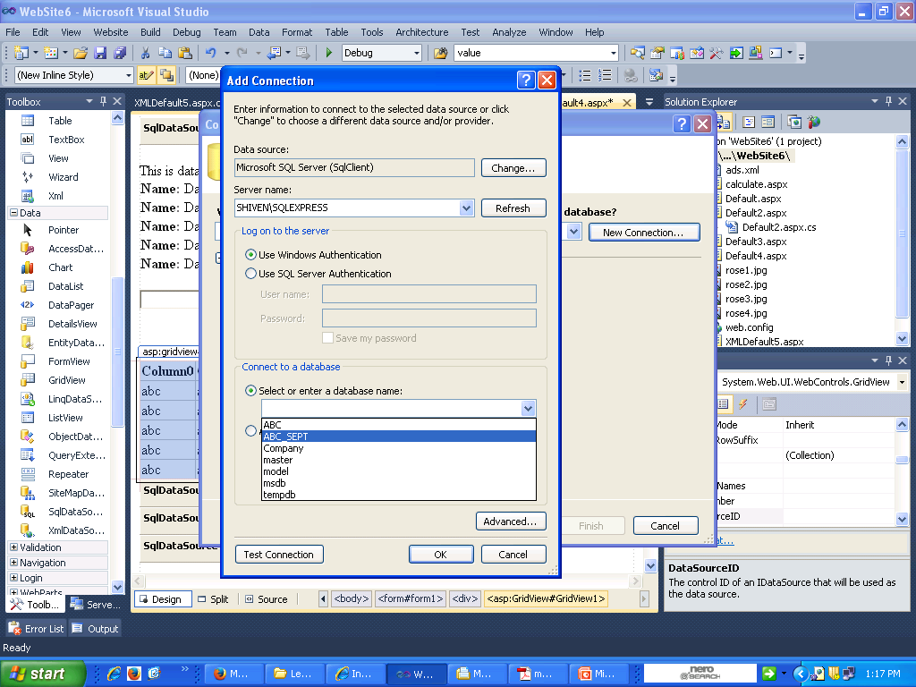
Using DataGrid Control Cont…

Slide 73
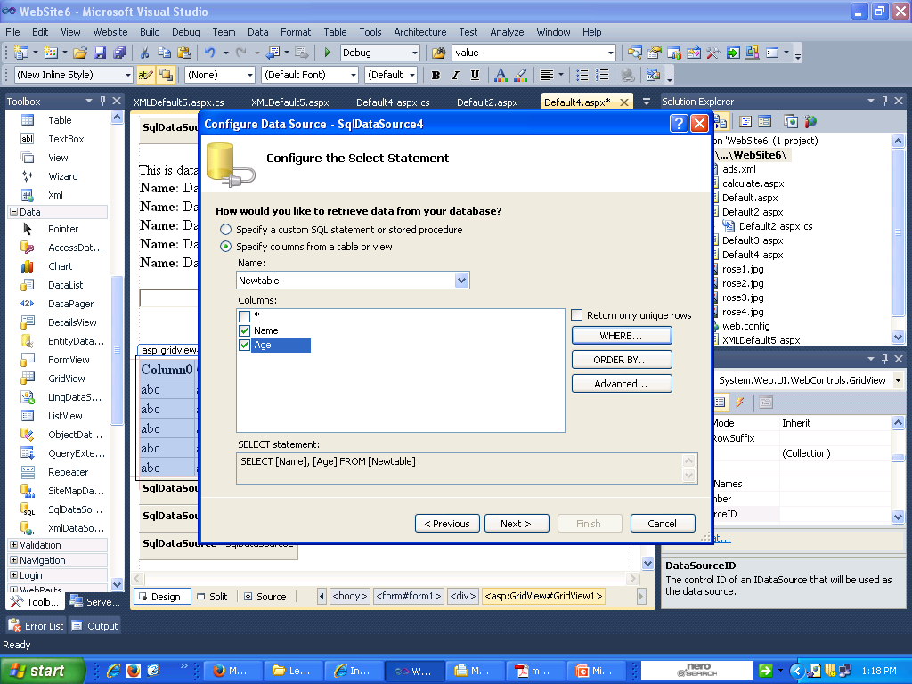
Using DataGrid Control Cont…

Slide 74
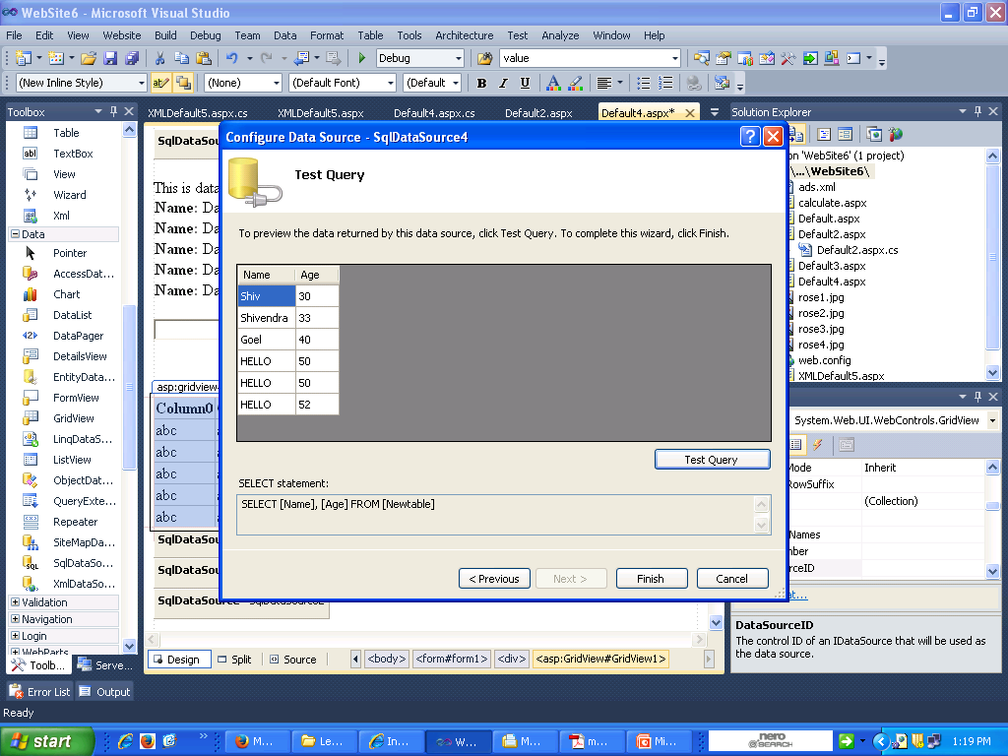
Using DataGrid Control Cont…

Slide 75
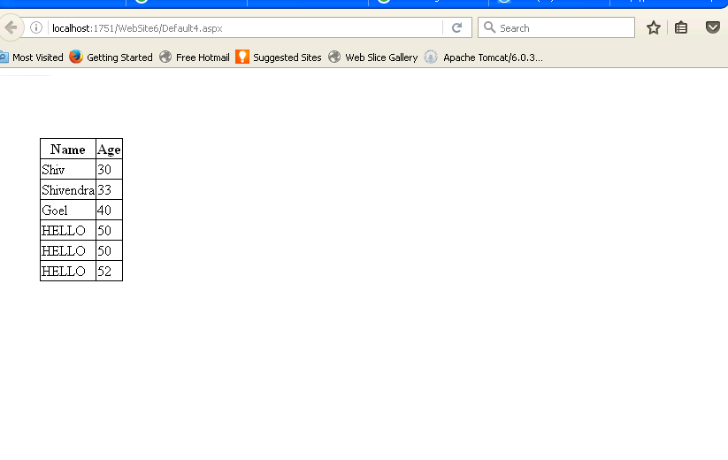
Using DataGrid Control Cont…

Slide 76
Adding Hyperlink to DataGrid Control
<asp:GridView ID="GridView1" runat="server" AutoGenerateColumns="False"
DataSourceID="SqlDataSource5"
onselectedindexchanged="GridView1_SelectedIndexChanged">
<Columns>
<asp:HyperLinkField DataTextField=“hyp_link" HeaderText=" hyp_link " DataNavigateUrlFields=" hyp_link " Target="_blank" />
<asp:BoundField DataField="roll" HeaderText="roll" SortExpression="roll" />
</Columns>
</asp:GridView>

Slide 77
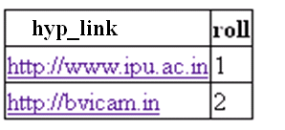
Adding Hyperlink to DataGrid Control

Slide 78
Working with datasets
A data set (or dataset) is a collection of data. Most commonly a data set corresponds to the contents of a single database table, or a single statistical data matrix, where every column of the table represents a particular variable, and each row corresponds to a given member of the data set.
The DataSet is specifically designed to help manage data in memory and to support disconnected operations on data, when such a scenario make sense.
The DataSet is an object that is used by all of the Data Providers, which is why it does not have a Data Provider specific prefix.

Slide 79
Binding Gridview with dataset
DataSet dset = new DataSet();
protected void Page_Load(object sender, EventArgs e)
{
SqlDataAdapter dadapter = new SqlDataAdapter("select * from Newtable", "Data Source=SHIVEN\\SQLEXPRESS;Initial Catalog=ABC_SEPT;Integrated Security=True");
dadapter.Fill(dset, "Newtable"); // Filling the DataSet with the records returned by SQL statemetns written in sqldataadapter

Slide 80
Binding Gridview with dataset
GridView1.DataSource = dset; // Binding the datagridview
GridView1.DataBind();
}

Slide 81
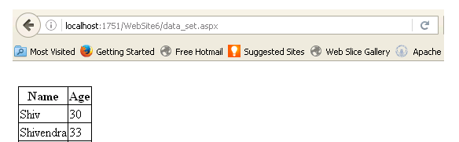
Binding Gridview with dataset

Slide 82
Binding Textbox with DataSet
protected void Button1_Click(object sender, EventArgs e)
{
SqlDataAdapter dadapter = new SqlDataAdapter("select * from Newtable", "Data Source=SHIVEN\\SQLEXPRESS;Initial Catalog=ABC_SEPT;Integrated Security=True");
DataSet dset = new DataSet();
dadapter.Fill(dset, "Newtable");
TextBox1.Text = dset.Tables[0].Rows[0]["Age"].ToString();
}

Slide 83
Working with XML…

Slide 84
XML
XML stands for EXtensible Markup Language
XML is a markup language much like HTML.
XML was designed to describe data.
XML tags are not predefined in XML. You must define your own tags.
XML is self describing.

Slide 85
XML - HTML
XML is not a replacement for HTML.
XML and HTML were designed with different goals
XML
HTML
XML was designed to describe data and to focus on what data is.
XML is about describing information.
XML allows the author to define his own tags and his own document structure.
HTML was designed to display data and to focus on how data looks.
HTML is about displaying information
The author of HTML documents can only use tags that are defined in the HTML standard.

Slide 86
About XML…
Extensible Markup Language (XML) is a markup language that defines a set of rules for encoding documents in a format that is both human-readable and machine-readable.
It is defined in the XML 1.0 Specification produced by the W3C, and several other related specifications.

Slide 87
Some facts you already know…
XML stands for EXtensible Markup Language
XML is a markup language much like HTML.
XML was designed to carry data, not to display data(HTML).
XML tags are not predefined. You must define your own tags.
XML is designed to be self-descriptive.

Slide 88
Difference Between XML and HTM
XML is not a replacement for HTML.
XML and HTML were designed with different goals:
  XML was designed to transport and store data, with focus on what data is
  HTML was designed to display data, with focus on how data looks
  HTML is about displaying information, while XML is about carrying information.

Slide 89
XML Cont..
using System.Xml;
using System.Data;
protected void Button1_Click(object sender, EventArgs e)
{
string myXMLfile = “C::/ads.xml";
DataSet ds = new DataSet();
{
ds.ReadXml(myXMLfile);
DataRow dr = (DataRow)ds.Tables[0].Rows[ds.Tables[0].Rows.Count - 1];
TextBox1.Text = Convert.ToString(ds.Tables[0].Rows.Count - 1);
int i, j;
j = Int32.Parse(TextBox1.Text);
for (i = 0; i <= j; i++)
{
TextBox1.Text = ds.Tables[0].Rows[i]["NavigateUrl"].ToString();
TextBox2.Text = ds.Tables[0].Rows[i]["AlternateText"].ToString();
Label1.Text= Label1.Text + "<a href=" +TextBox1.Text+">"+TextBox2.Text+"</a></br>";
}
}
}

Slide 90
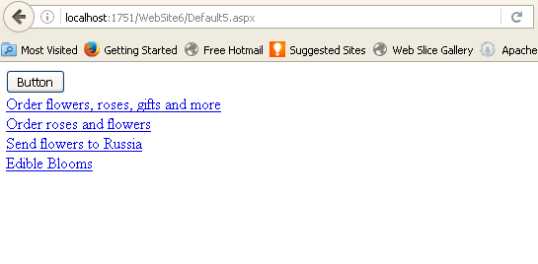
XML Cont..

